Slide 1
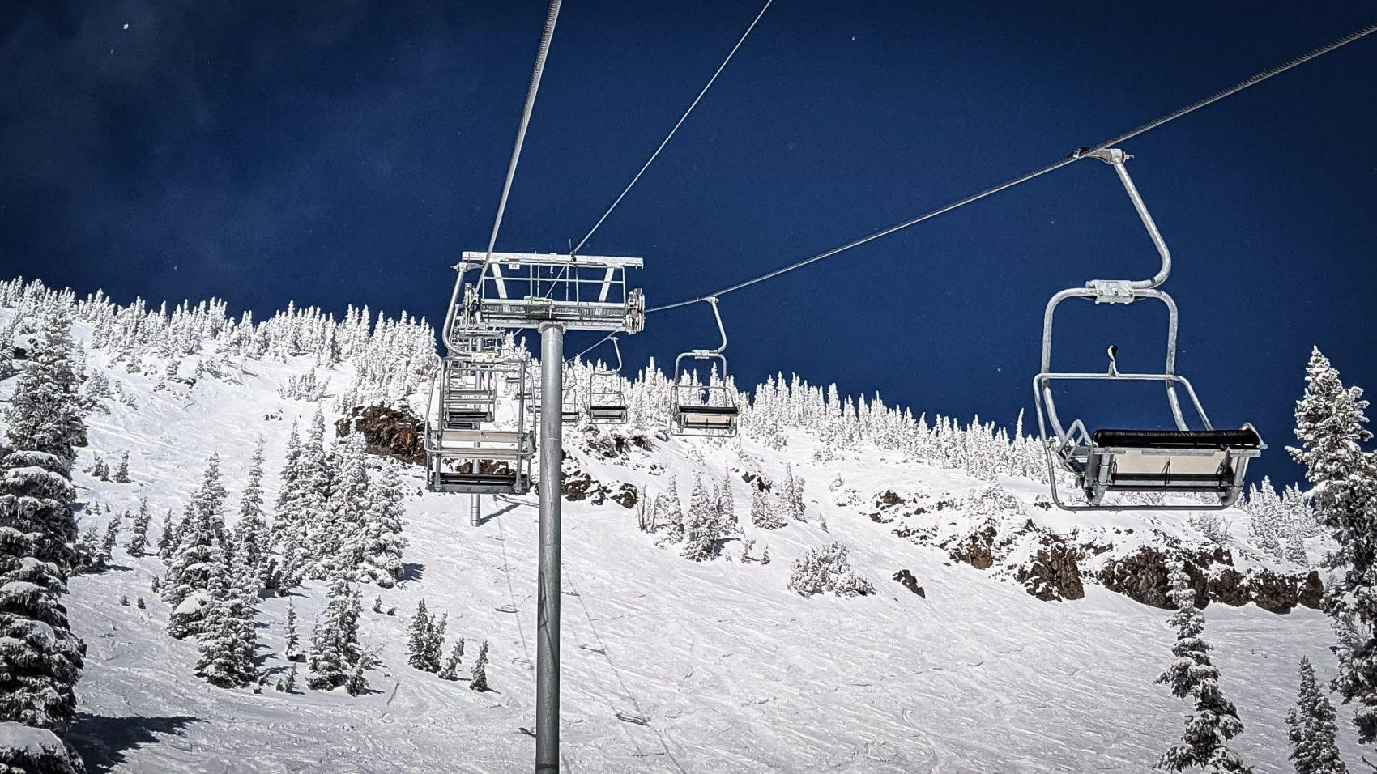
Big Mountain Resort
Price Modeling
Elijah Wikenheiser

Slide 2
Problem Identification
How can Blue Mountain Resort increase revenue to cover the additional $1.54B in operating costs this season?
Current pricing strategy has been to charge a premium above the average price of resorts in its market segment.
A CSV containing data about chairlifts, runs, days of operation, ticket prices, etc. was provided by the database manager.

Slide 3
Recommendation
Tickets should be raised from the current price of $81 to $95.
This adjusted price would lead to an increased annual revenue of $27,772,500.
The additional chairlift is expected to increase revenue by $3.47M, offsetting the $1.54M operating cost.
Given run closure modelling, it would be possible to close runs on slower days without significant decrease to revenue.

Slide 4
Modeling Results
Two models were built for price prediction:
Linear Regression model
Resulted in a Mean Absolute Error of ~$10.50
Random Forest Regression model
Resulted in a Mean Absolute Error of ~$9.60

Slide 5
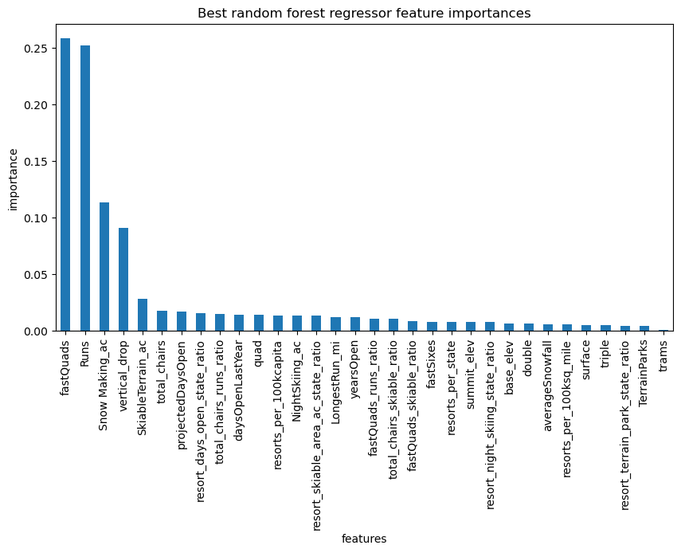
Analysis
Dominant top four features
fastQuads
Runs
Snow Making_ac
Vertical drop

Slide 6
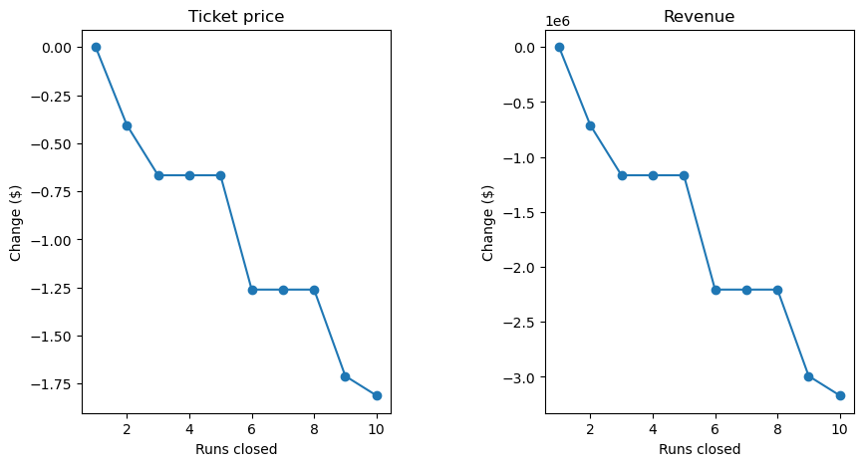
Analysis
Modeling provides evidence that closing 1 run makes no difference in revenue. When closing 3, up to 5 can be closed with no further decrease in revenue.

Slide 7
Summary
Recommended price is $95. Even with the MAE for the random forest model at ~$9.50, there suggests room for ticket price increase.
Important features to determine resort value appear to be
fastQuads
Runs
Snow Making
Vertical Drop
Additional data to consider for model improvement could include
Amount of sales of 1, 3, and 5 day tickets
Number of chalets per resort
Additional lift options like rope-tows and magic carpets
Ticket sales per year.

